Slide 1
The future of SOK Stores
and Chains applications
Focus on Application Operations and Business Process Support
Capgemini
31st August 2015

Slide 2
Topsi Service Today
Topsi Service Evolution
Topsi Service Way Forward

Slide 3
Current Topsi service includes three main service elements: Service Desk, Service Management and Service Support
SOK Chains’ and Stores’ Business
Service Desk Level 0 + 1
TILHAL
TAVHAL
VALHAL
RAPANA
ENNOPT
Service Desk Level 2 (Process and Application Support)
Project Management Office
Projects
Service Management
Service Delivery Manager
CSI Manager
Service Performance & Service Management:
Service Level Management, Service Reporting, Continuous Service Improvement
Cross Service Tower Operations:
Incident Management, Problem Management, Change Management, Event Management, Release & Deployment Management, Knowledge Management, Request Fulfilment, Service Asset Management, Capacity Management, Configuration Management, Availability Management
Development
Operations
Service Support
Business Process Area Lead
Business Process Area Lead
Production Manager
Technical Lead
Technical Lead
Technical Lead
Technical Lead
Technical Lead
Database Support services, Datastage Support services, Batch Support services, Middleware and Microstrategy Support services
Infrastructure Monitoring
Infrastructure

Slide 4
Projects are priced separately, Middleware Support is part of the Topsi fixed fee service
SOK Chains’ and Stores’ Business
Service Desk Level 0 + 1
TILHAL
TAVHAL
VALHAL
RAPANA
ENNOPT
Service Desk Level 2 (Process and Application Support)
Service Management
Service Delivery Manager
CSI Manager
Service Performance & Service Management:
Service Level Management, Service Reporting, Continuous Service Improvement
Application & Process Related Service
Topsi Fixed Fee Service
Cross Service Tower Operations:
Incident Management, Problem Management, Change Management, Event Management, Release & Deployment Management, Knowledge Management, Request Fulfilment, Service Asset Management, Capacity Management, Configuration Management, Availability Management
Service Support
Business Process Area Lead
Business Process Area Lead
Production Manager
Technical Lead
Technical Lead
Technical Lead
Technical Lead
Technical Lead
Database Support services, Datastage Support services, Batch Support services, Middleware and Microstrategy Support services
MW
Infrastructure Monitoring
Infrastructure

Slide 5
Topsi Service Today
Topsi Service Evolution
Topsi Service Way Forward

Slide 6
Most likely Service Desk Level 1 will be moved under a new contract, which will impact the service scope somewhat
New Contract
SOK Chains’ and Stores’ Business
Service Desk Level 0 + 1
TILHAL
TAVHAL
VALHAL
RAPANA
ENNOPT
Service Desk Level 2 (Process and Application Support)
Service Management
Service Delivery Manager
CSI Manager
Service Performance & Service Management:
Service Level Management, Service Reporting, Continuous Service Improvement
Cross Service Tower Operations:
Incident Management, Problem Management, Change Management, Event Management, Release & Deployment Management, Knowledge Management, Request Fulfilment, Service Asset Management, Capacity Management, Configuration Management, Availability Management
Application & Process Related Service
Topsi Fixed Fee Service
Service Support
Business Process Area Lead
Business Process Area Lead
Production Manager
Technical Lead
Technical Lead
Technical Lead
Technical Lead
Technical Lead
Database Support services, Datastage Support services, Batch Support services, Middleware and Microstrategy Support services
MW
Infrastructure Monitoring
Infrastructure

Slide 7
The Application Operations that keep the applications available for business is the critical “Core” of Topsi Service
SOK Chains’ and Stores’ Business
Service Desk Level 0 + 1
TILHAL
TAVHAL
VALHAL
RAPANA
ENNOPT
Service Desk Level 2 (Process and Application Support)
Service Management
Service Delivery Manager
CSI Manager
Service Performance & Service Management:
Service Level Management, Service Reporting, Continuous Service Improvement
Cross Service Tower Operations:
Incident Management, Problem Management, Change Management, Event Management, Release & Deployment Management, Knowledge Management, Request Fulfilment, Service Asset Management, Capacity Management, Configuration Management, Availability Management
Service Support
Business Process Area Lead
Business Process Area Lead
Production Manager
Technical Lead
Technical Lead
Technical Lead
Technical Lead
Technical Lead
Database Support services, Datastage Support services, Batch Support services, Middleware and Microstrategy Support services
Infrastructure Monitoring
Infrastructure

Slide 8
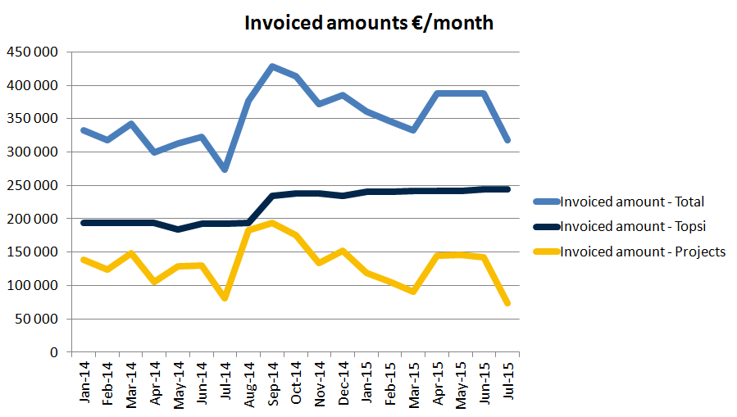
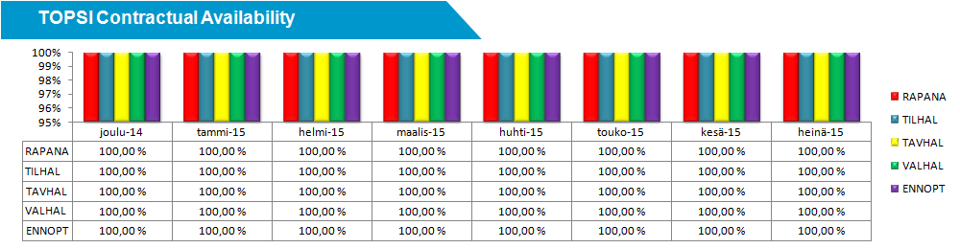
This Topsi Core is delivered in an industrialized model utilizing ITIL processes and high off-shore penetration
SOK Chains’ and Stores’ Business
Service Desk Level 0 + 1
TILHAL
TAVHAL
VALHAL
RAPANA
ENNOPT
Topsi’s mission is to keep SOK Chains’ and Stores’ applications available for business.
Current monthly fixed fee is ~ 230 k€ including application & process related services and middleware support.
Currently Capgemini Topsi team size exceeds 50 FTE total in Finland and India.
Cost-efficiency is achieved through offshoring and industrialization.
In comparison: Delivering…
all the same Topsi service elements as today
on the same service levels as today
with onshore resources only…
would more than double Topsi cost level even if the service would be delivered with half the FTE effort onshore.
(25 FTE, 21 days a month, 7,5 hrs/day, 120 €/hr => 473 k€ / month)
Infrastructure Monitoring
Infrastructure

Slide 9
Even if we separate Middleware support from the scope the business critical AO core – and majority of work – remains
The business critical AO core of Topsi service requires business process area knowledge and capability to maintain the applications so that they are available for business.
SOK Chains’ and Stores’ Business
Service Desk Level 0 + 1
TILHAL
TAVHAL
VALHAL
RAPANA
ENNOPT
Service Desk Level 2 (Process and Application Support)
Service Management
Service Delivery Manager
CSI Manager
Service Performance & Service Management:
Service Level Management, Service Reporting, Continuous Service Improvement
Cross Service Tower Operations:
Incident Management, Problem Management, Change Management, Event Management, Release & Deployment Management, Knowledge Management, Request Fulfilment, Service Asset Management, Capacity Management, Configuration Management, Availability Management
Service Support
Business Process Area Lead
Business Process Area Lead
Production Manager
Technical Lead
Technical Lead
Technical Lead
Technical Lead
Technical Lead
Database Support services, Datastage Support services, Batch Support services, Middleware and Microstrategy Support services
Infrastructure Monitoring
Middleware support requires mainly technology specific competencies and the delivery can be industrialized by implementing delivery factories across different services / clients using same technology stack.
Infrastructure

Slide 10
The AO core can be developed by further industrialization, streamlining processes and increasing automation level…
SOK Chains’ and Stores’ Business
Service Desk Level 0 + 1
TILHAL
TAVHAL
VALHAL
RAPANA
ENNOPT
Service Desk Level 2 (Process and Application Support)
Service Management
Service Delivery Manager
CSI Manager
Service Performance & Service Management:
Service Level Management, Service Reporting, Continuous Service Improvement
Cross Service Tower Operations:
Incident Management, Problem Management, Change Management, Event Management, Release & Deployment Management, Knowledge Management, Request Fulfilment, Service Asset Management, Capacity Management, Configuration Management, Availability Management
Service Support
Business Process Area Lead
Business Process Area Lead
Production Manager
Technical Lead
Technical Lead
Technical Lead
Technical Lead
Technical Lead
Database Support services, Datastage Support services, Batch Support services, Middleware and Microstrategy Support services
Infrastructure Monitoring
Infrastructure

Slide 11

…but the major savings can be realized by developing the whole pipeline from development to operations
Move from Waterfall to Agile Development
Build Continuous Integration
Increase Offshore Penetration
Build Continuous Delivery
Increase Automation Level
Delivery Orchestration
Agile Development
Continuous Integration
Continuous Delivery
Dynamic Capacity
Automated Testing
DEV
Application Performance Monitoring
TEST
Business
Optimized cycle time
PROD
Utilize the Cloud Opportunities
Continuous Feedback Loop

Slide 12
Topsi Service Today
Topsi Service Evolution
Topsi Service Way Forward

Slide 13
Within the current Topsi scope we propose the following
Assumptions
No major transformation to agile end-to-end pipeline model will take place in Topsi in near future:
Application Development is done as today by 3rd party and release packs will be delivered to Topsi
Infrastructure transitions to 3rd party infra capacity will be completed as planned by end of 2015
Topsi Service Desk level 1 operations will be moved under new contract (during 1Q2016)
Otherwise Topsi scope will remain the same as today (service extensions discussed handled separately)
Way Forward
Topsi service current monthly fixed fee: 231 k€ with > 70% offshore ratio
Our proposal for 2016:
Level 1 Service Desk removed to separate contract: - 7 350 € / month
Industrialized Middleware and Database support delivery model implemented: - 8 300€ / month
Service extensions discussed (on top of the current scope):
Development environments to service scope: + 1 000 € / month
New applications to Topsi scope:
Relex PT, KT & Sokos, REX, Polttonestehinnoittelu, Sokos reporting: + 12 700 € / month
Fosteri: + 2 120 € / month
Price indications are preliminary and will be adjusted when final proposals are made
With current Topsi scope the service SLA’s will remain unchanged but monthly fee will decrease ~7 %

Slide 14
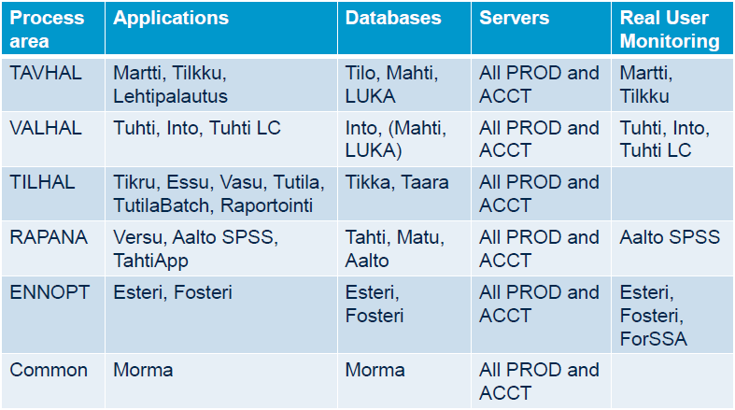
In addition, implementation of state of the art monitoring solution improves service efficiency and reliability
Assumptions
The core of the monitoring solution is AppDynamics Application Performance Monitoring
that provides visibility to applications and dramatically improves incident and problem
management and root cause analysis efficiency.
The remaining parts of total monitoring solution (monitoring outside AppDynamics)
will be handled separately with other tools.
AppDynamics APM will implemented to the Topsi scope as proposed in July 2015.
Way Forward
AppDynamics implementation starts in September following the original project schedule:
ESSU monitoring to be implemented first
Monitoring solution service (including licences) added Topsi scope: + 51 000 € / month
One-time implementation project cost: AppDynamics work + 113 000 € + Capgemini work 75 000 €
Current application monitoring can be ramped down: cost savings – XX XXX € / month
Price indications are preliminary and will be adjusted when final proposals are made
After full implementation of AppDynamics in Topsi service scope we commit to further -15%
reduction in Topsi service monthly fee excluding the monitoring solution service.

Slide 15
Our approach has number of tangible benefits
Benefits
Avoided risk of business process interruptions caused by AO transitions of business critical applications
Shorter downtimes due to Application Perfomance Monitoring and improved incident and problem management
Gain the cost benefits of high off-shore penetration
Capgemini’s commitment to decreased service monthly fee
Capgemini’s commitment to additional reductions in service monthly fee after APM implementation
Savings achieved by terminating existing application monitoring license fees
Predictability of SLA based Fixed Price service instead of using T&M based AO work
Business Continuity
Cost Efficiency
Predictability

